Slide 1



Slide 1
Garbage container with automatic opening/closing and movement towards the subject by responding electronic signal.
Presented by –
1.Saptarshi Mondal (UG/02/LATBTME/2017/001)
2. Brotati Chakraborty (UG/02/2016/008)
3.Razon Kr. Biswas (UG/02/2016/001)
Under the Supervision of
1.Mr. Soumyabrata Basak, Asst. Professor, Dept. of Mechanical Engineering.
2.Mr. Nisarga Chand, Asst. Professor, Dept. of Electronics and Communication Engineering.

Slide 2

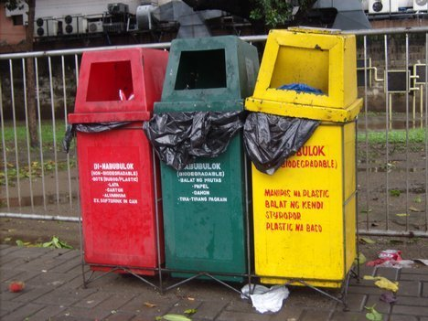
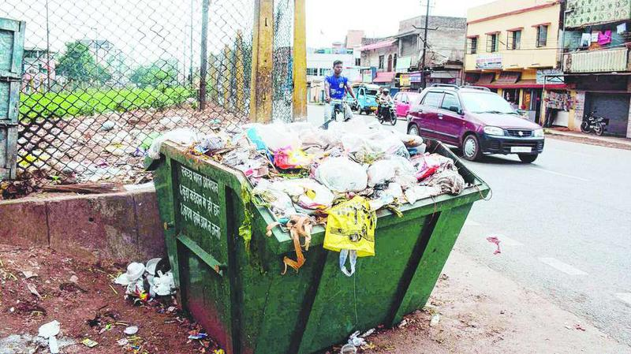
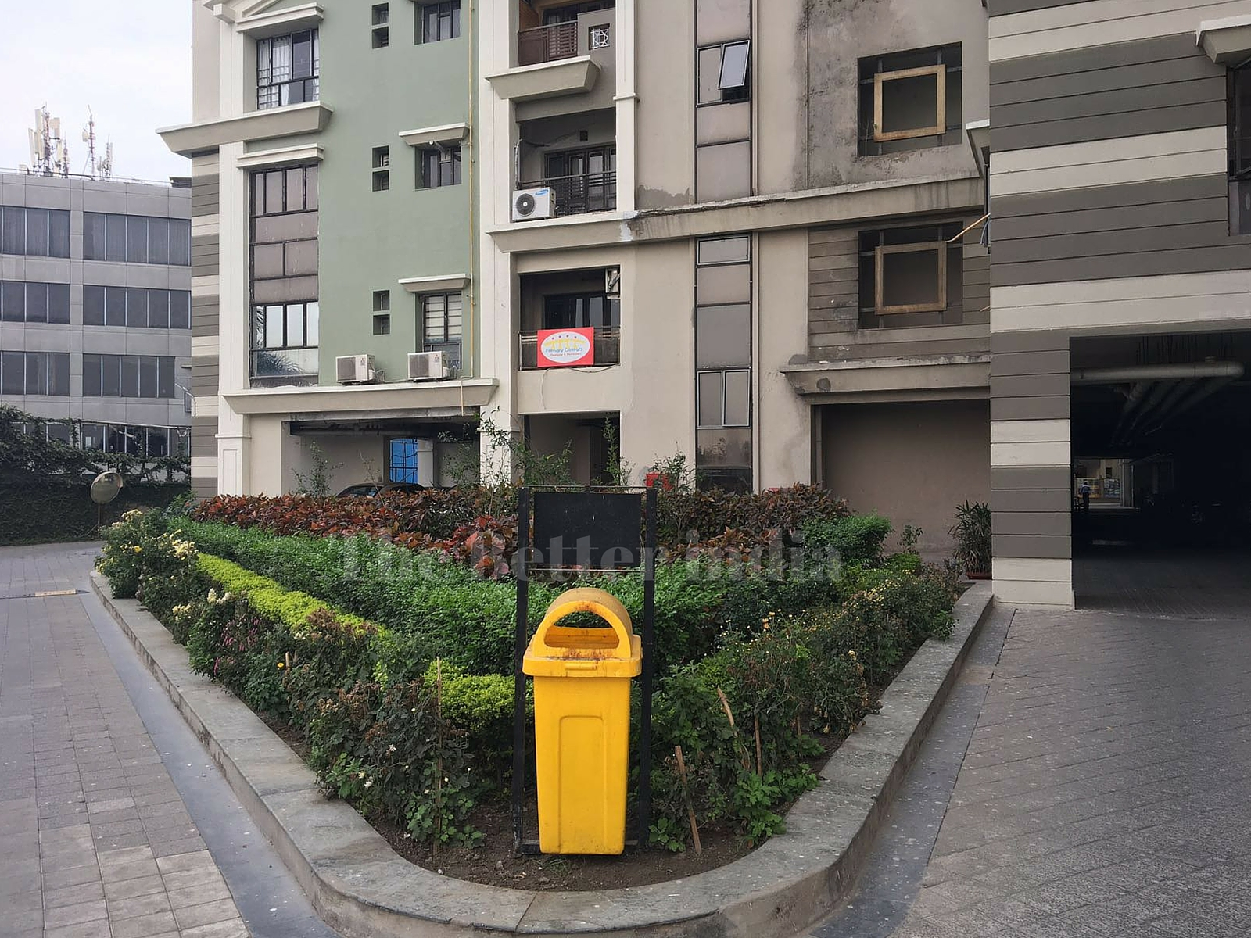
AREA OF FOCUS
IMAGE SOURCE : GOOGLE

Slide 3

Motivation
This project has been inspired by Swachh Bharat Abhiyan (SBA) or Swachh Bharat Mission (SBM) is a nation-wide campaign in INDIA for the period 2014 to 2019 that aims to clean up the streets, roads and infrastructure of India's cities, towns, and rural areas.
The objectives of Swachh Bharat include eliminating open defecation through the construction of household-owned and community-owned toilets and establishing an accountable mechanism of monitoring toilet use.

Slide 4

IMPORTANCE AND OBJECTIVES
It helps to solve the problems related to the garbage management.
It will make people more comfortable to use the bin properly.
Hassel free usage in any large commercial space.
${360}^{0}$ movement.
Alarming the owner when it is full of garbage.

Slide 5
Literature survey
Less investment in progress of waste management system
Creating health Issue all over the world.
The total amount of waste generated in India is approximately 1.3 pounds per person every single day.
4.6 pounds of waste generated per person everyday in the United State (U.S.).
U.S. population was approximately 307 million in July 2009, whereas India’s population was 1.2 billion. These statistics shows that India is generating almost 27 million more tons of waste than the U.S. every year .
To manage this garbage, there are some methods that has already been developed. The first method was developed using LCD and weight sensor.
In proposed system Ardiuno Uno board along with ultrasonic sensor is used for the entire communication and signal system.

Slide 6
Slide 6
WORK PLAN
DESIGN OF THE PRODUCT.
POST PRODUCTION.
CODING.
TESTING CODE WITH MOTORS.
ASSEMBLY.
TRIAL RUN FOR QUALITY CHECK.

Slide 7
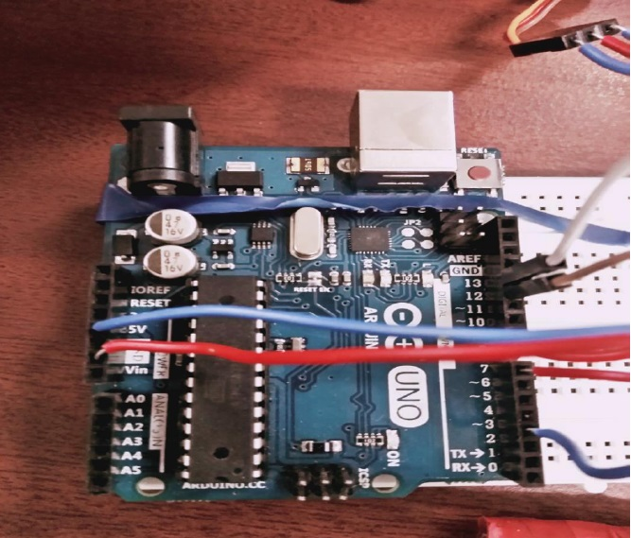
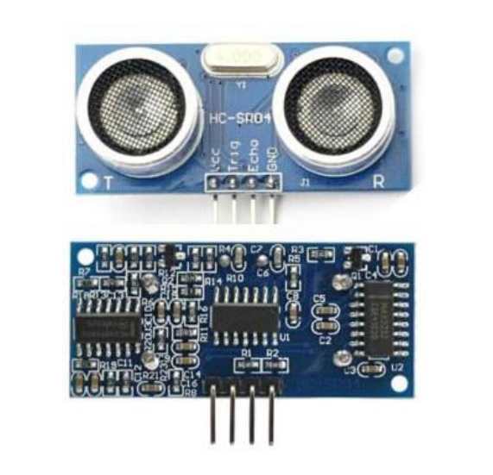
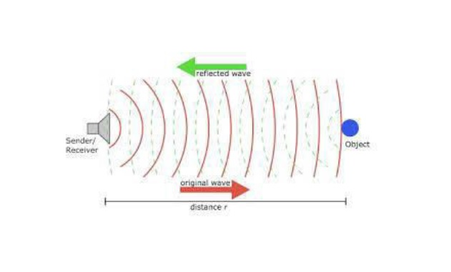
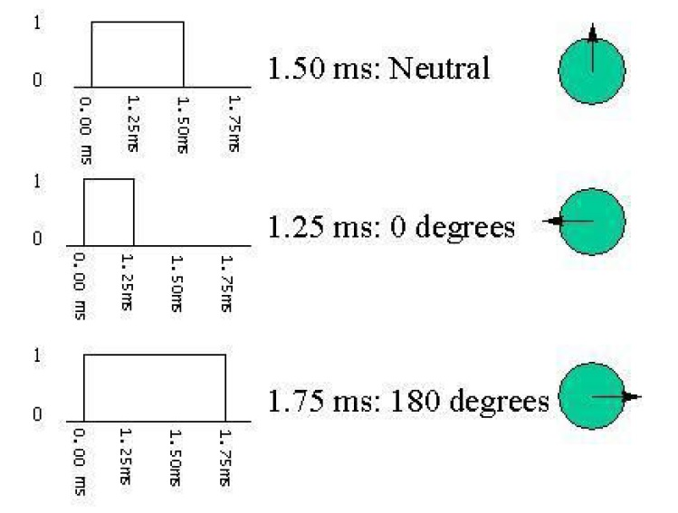
Equipment Details

Slide 8

USER FRIENDLY ADD ON FEATURES
SCAN & DOWNLOAD

Slide 9
Components Required
• Arduino
• Ultrasonic Sensor
• 300 RPM BO Motors
• Wheels
• L293D Motor Driver
• 2300 MAH LIPO Battery
• Buzzer Module
• Servo Motors
• HC06 Bluetooth Module
• Connecting wires

Slide 10
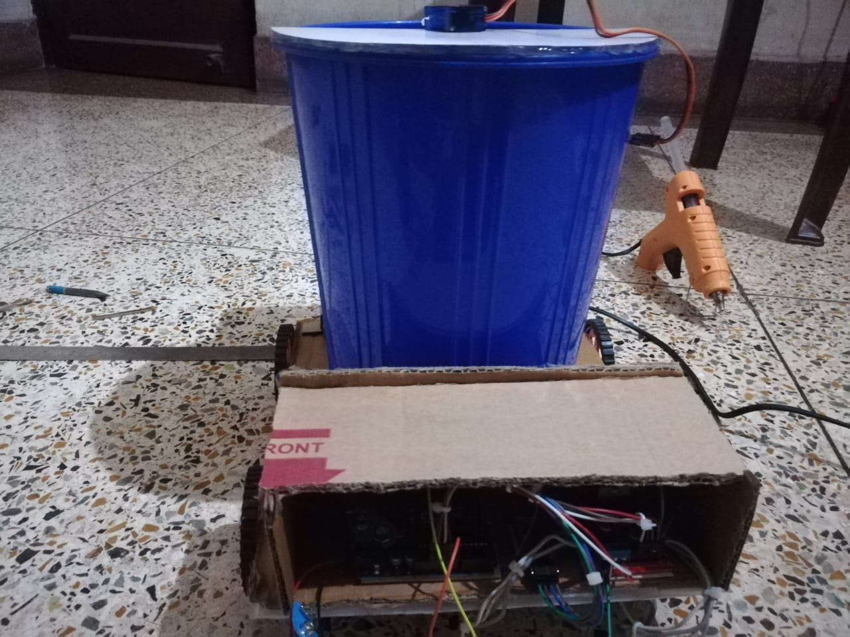
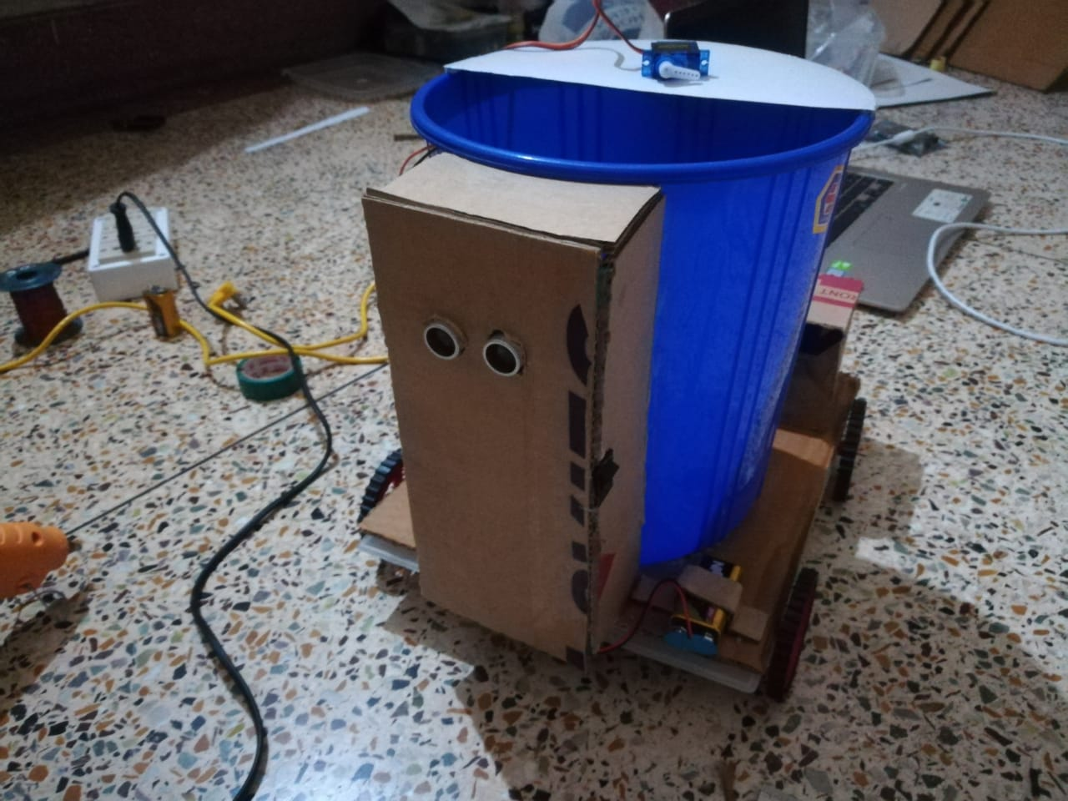
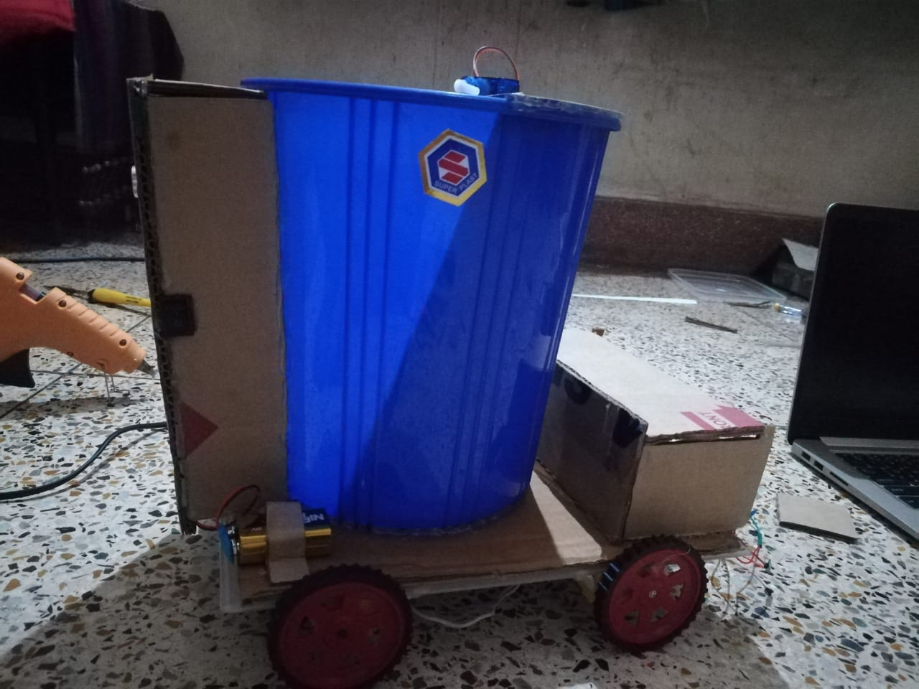
WORK PROGRESS

Slide 11
RESULT AND DISCUSSION
As a result we have been successfully made it complete 360 degree movement.
After completing the entire movement using HC06 Bluetooth module, we focused on the garbage container which include another programming part for opening and closing the container automatically after reach the signal via ultrasonic sensor.
The Arduino we used are Uno board which is a microcontroller based on the ATmega328. It has 14 digital input/output pins in which 6 can be used as PWM outputs, a 16 MHz ceramic resonator, an ICSP header, a USB connection, 6 analogy inputs, a power jack and a reset button. This contains all the required support needed for microcontroller.
And the ultrasonic we used in the container is
emit short, high-frequency sound pulses at regular intervals. ... If they strike an object, then they are reflected back as echo signals to the sensor, which itself computes the distance to the target based on the time-span between emitting the signal and receiving the echo.

Slide 12
CONCLUSION
This project work is the implementation of Automatic Garbage Fill Alerting system using Ultrasonic sensor, Arduino Uno, Buzzer and. This system assures the cleaning of dustbins soon when the garbage level reaches its maximum.. If the dustbin is not cleaned in specific time, then the record is sent to the owner or higher authority who can take appropriate action against the concerned Person (for commercial places). This reduces the total number of trips of garbage collection vehicle and hence reduces the overall expenditure associated with the garbage collection. It ultimately helps to keep cleanliness in the society. Therefore, the Automatic Garbage Fill Alerting system makes the garbage collection more efficient.

Slide 13
FUTURE SCOPE
Speech recognition control.
Dustbin will Classify the waste whether it is degradable or non degradable.

Slide 14
References
[1]. S.S. Navghane, M.S. Killedar, Dr.V.M. Rohokale,‖ IoT Based Garbage and Waste Collection Bin‖, May 2016.
[2]. Ghose, M.K., Dikshit, A.K., Sharma, S.K. A GIS based transportation model for solid waste disposal – A case study on Asansol municipality. Journal of Waste Management.
[3]. Guerrero, L.A., Maas, G., Hogland, W.: Solid waste management challenges for cities in developing countries. Journal of Waste Management.
[4]. Alexey Medvedev, Petr Fedchenkov, ArkadyZaslavsky, Theodoros,
Anagnostopoulos Sergey Khoruzhnikov,‖Waste Management as an IoT-Enabled Service in Smart Cities‖.
[5]. Meghana K C, Dr. K R Nataraj,‖ IOT Based Intelligent Bin for Smart Cities‖.
[6]. KasliwalManasi H., SuryawanshiSmitkumar B, A Novel Approach to Garbage Management Using Internet of Things for Smart Cities‖.
[8]. Monika K A, Nikitha Rao, Prapulla S B, Shobha G, Smart Dustbin-An Efficient Garbage Monitoring System.

Slide 15

Slide 10
THANK YOU

